Slide 1

LINEAR PROGRAMMING
Prof. Zhenyu He
Harbin Institute of Technology (Shenzhen)
Autumn 2020

Slide 2
A Political Problem
Policy | urban | suburban | rural
Build roads | -2 | 5 | 3
Gun control | 8 | 2 | -5
Farm subsidies | 0 | 0 | 10
Gasoline tax | 10 | 0 | -2
The effect of policies on voters.

Slide 3
We format this problem as
Minimize:
Subject to:

Slide 4
General linear programs
Linear equality
Linear inequality
or

Slide 5

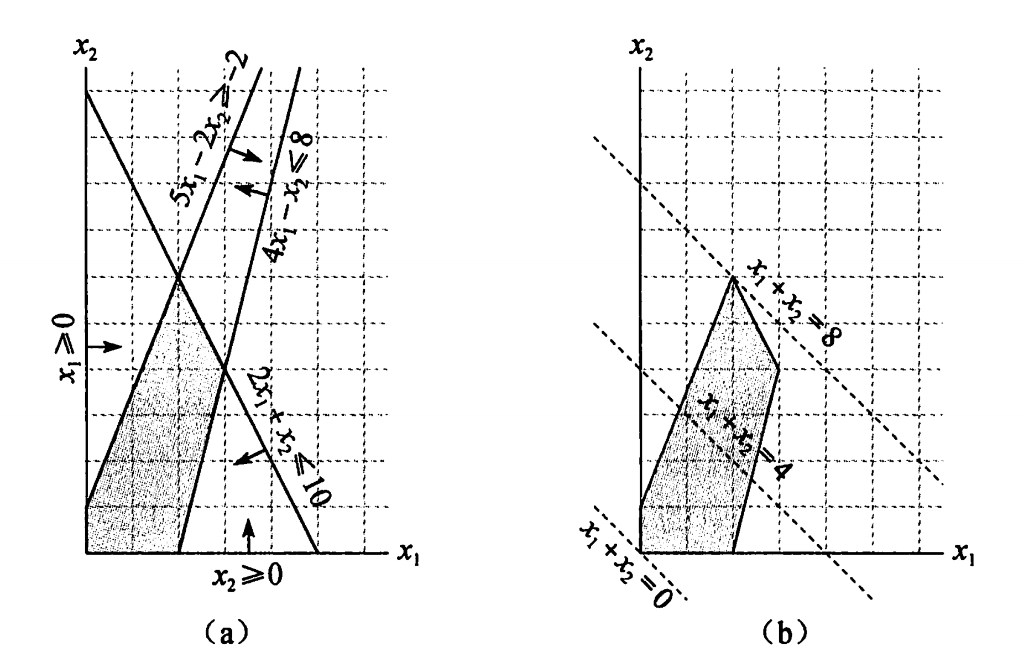




Considering one linear program with two variables
Maximize:
Subject to:
$$5x_{1}−2x_{2}≥−2$$

Slide 6
Although we cannot easily graph linear programs with more than two variables, the same intuition holds.
If we have three variables, then each constraint is described by a half-space in three dimensional space. The intersection of these half-space froms the feasible region.
If we have n variables, then each constraint is described by a half-space in n dimensional space. The intersection of these half-space froms the feasible region.

Slide 7
Standard Form
In standard form, we are given n real numbers ;
m real numbers ;
and mn real numbers for and ;
Finding n real numbers that
Maximize:
Subject to:
for
for

Slide 8



This linear program can be rewritten as,
Maximize：
Subject to：
where
$$A=\left(a_{ij}\right) b=\left(b_{i}\right) c=\left(c_{j}\right) x=(x_{j})$$
A tuple (A, b, c) can represent a linear program in standard form.
Notes:
a_{ij}, b_{i}, c_{j}, x_{j}

Slide 9
Converting linear programs into standard form
For example, if we have the linear program ;
Minimize:
Subject to:

Slide 10
By negating the coefficients of the objective function,
we get
Maximize:
Subject to:

Slide 11
To ensure that each variable has a non-negativity constraint,
we have
Maximize:
Subject to:

Slide 12
For consistency in variable names,
we have
Maximize:
Subject to:

Slide 13
Converting linear programs into slack form;
We introduce slack variables x₄ ,x₅ ,x₆, the linear programs we just
discuessed can be written as
Minimize:
Subject to:

Slide 14



As in standard form, we use b_{i}, c_{j} and a_{ij} to denote constant terms and coefficients. Thus we can concisely define a slack form by a tuple (N, B, A, b, c, v) to denote the slack form
for
Here, the equations is indexed by B and the variables on the right-hand is indexed by N.

Slide 15






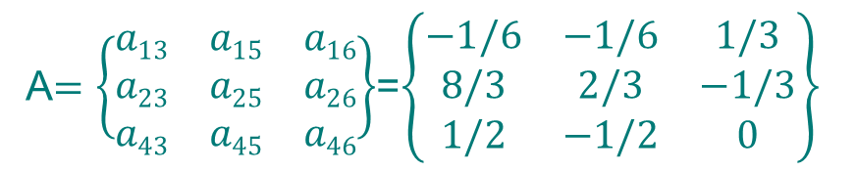

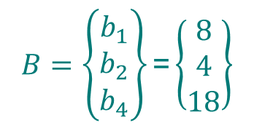
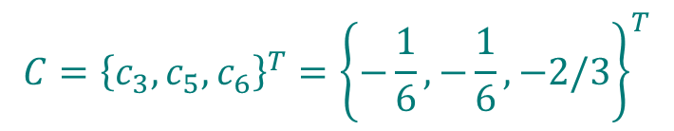
For example, in the slack form
We have
$$B=\left\{\begin{aligned}b_{1} \\ b_{2} \\ b_{4}\end{aligned}\right\}\text{=}\left\{\begin{aligned}8 \\ 4 \\ 18\end{aligned}\right\}$$
$$C={\left\{c_{3},c_{5},c_{6}\right\}}^{T}={\left\{−\frac{1}{6},−\frac{1}{6},−2/3\right\}}^{T}$$

Slide 16
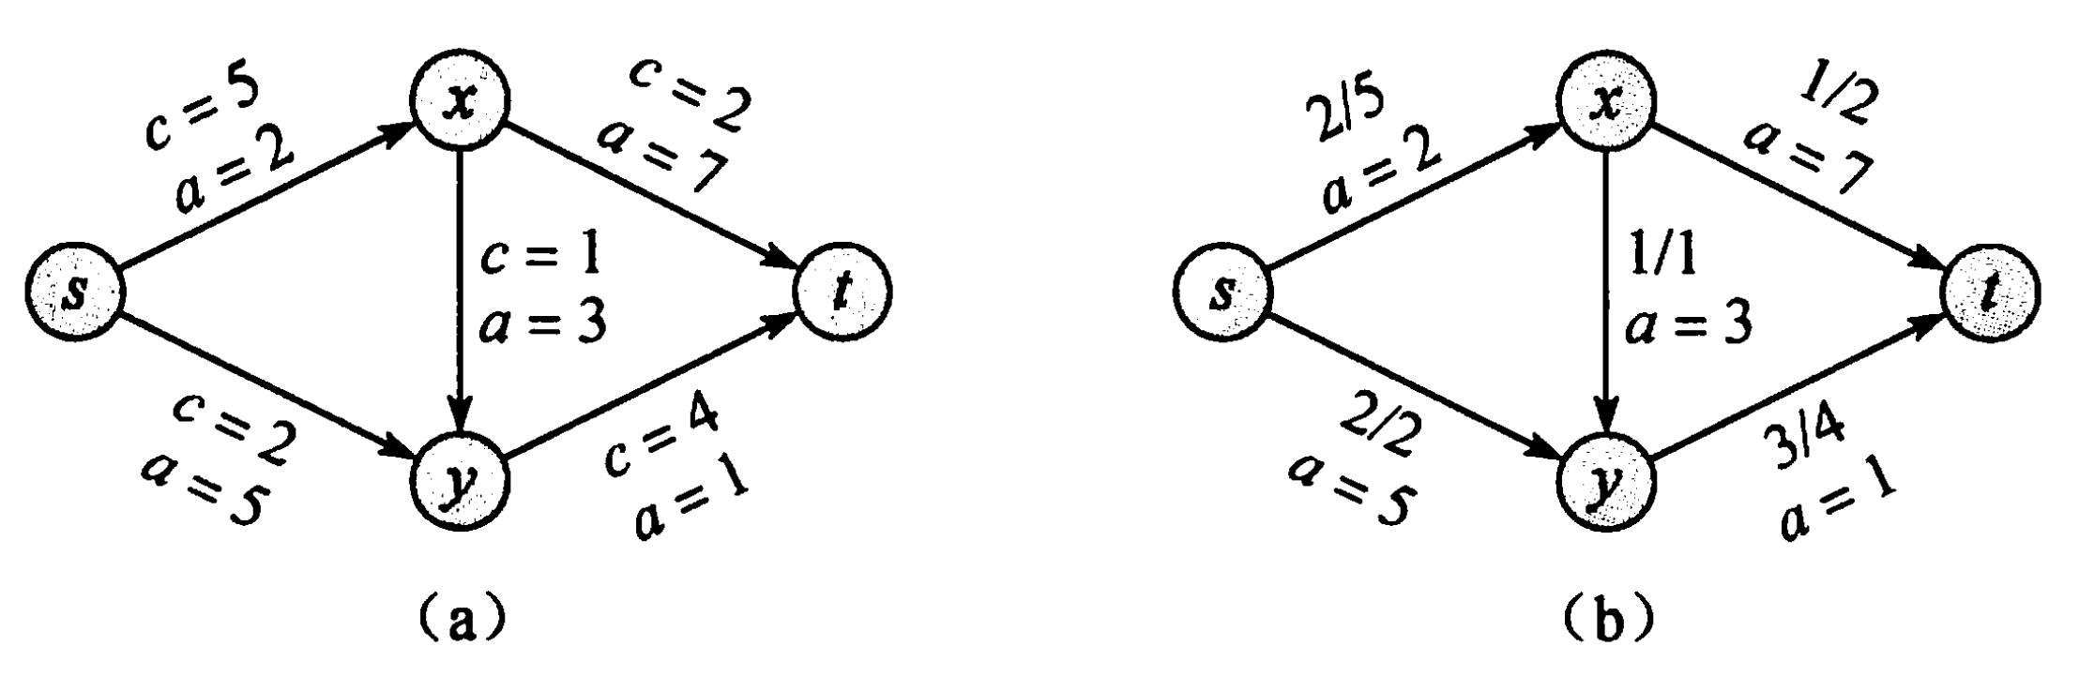
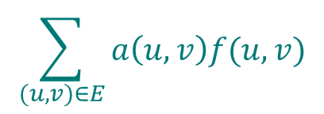




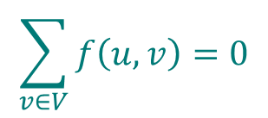

Minimum cost flow
Maximize:
Subject to:
for each
for each
for each

Slide 17





The simplex algorithm
Consider the following linear program in standard form:
Maximize:
Subject to:

Slide 18




In order to use the simplex algorithm, we must convert the linear program into slack form
Maximize:
Subject to:
This system has 3 equations and 6 variables, and therefore has an infinite number of solutions.
Basic solution:
If a basic solution is also feasible, we call it a basic feasible solution.

Slide 19






Since the third constraint is the tightest constraint, we switch x₁ and x₆.
The linear program is rewritten as
The operation is call pivot.
New basic solution:
New objective function:

Slide 20
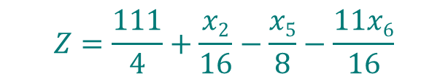



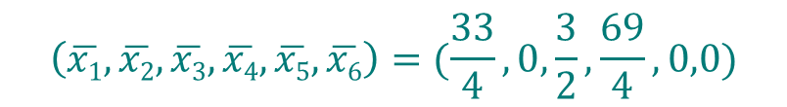

Since the third constraint is the tightest constraint again, we switch x₃ and x₅.
The linear program is rewritten as
New basic solution:
New objective function:

Slide 21
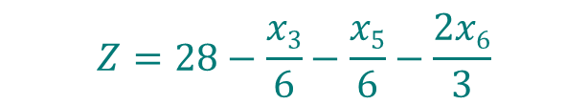




Now the only way to increase the objective value is to increase x₂.
The linear program is rewritten as
All coefficients in the objective function are negative, as means the basic solution is the optimal solution.
Basic solution(also optimal solution):
Objective function(also final solution) :

